Slide 1

HYBRID DATA STRUCTURES: INDEXED AVL TREE

Slide 2
WHAT IS A HYBRID DATA STRUCTRURE?
A hybrid data structure is a combination of 2 or more pre-existing data structure which are used to solve complex problems in an efficient manner.
They are designed in such a way that, they reap the benefits of the existing data structures and minimize their weaknesses.
With the ability to solve complex problems, they form an essential part for developing high performance applications.

Slide 3
WHAT IS AN AVL TREE?
An Adelson-Velskii and Landis Tree is a binary search tree with a self-balancing property.
The self-balancing property ensures that the absolute difference of the left and right subtrees in a BST is always zero or one.
The advantage of maintaining a balanced BST guarantees that the worst-case time complexities for the insertion ,deletion ,searching operations all give the same time complexity that is O(log n).

Slide 4
INDEXED AVL TREE HYBRID DATA STRUCTURE
The indexed AVL tree makes use of 2 data structures namely AVL Tree and an Array.
The AVL Tree is the heart of this hybrid data structures which ensures that tree is always balanced by performing rotation operations when necessary, so that the tree maintains a minimum height and optimizes the time complexities of various operations.
The Array on the other hand enables efficient index-based access to the tree elements. The elements of the AVL tree are stored in such a way that , the elements can be directly accessed by their index.

Slide 5
OPERATIONS THAT ACT AS THE BACKBONE FOR THE INDEXED AVL TREE
The key to create this indexing structure is the in-order traversal of the AVL tree. We know that the in-order traversal of any BST returns the tree elements in the ascending order. During this traversal, the elements are stored in the array.
While performing the in-order traversal, additional information is stored at each node of the AVL tree. This information includes the size of the subtree rooted at that node, which represents the number of nodes in that subtree. By maintaining this size information, it becomes possible to determine the index of any node in the AVL tree.

Slide 6
ADVANATAGES OF INDEXED AVL TREE
OVER NORMAL AVL TREE
The AVL tree provides efficient search operations which is highly beneficial when working with larger data sets, where fast retrieval of data is critical.
The array component of a hybrid data structure allows direct access to individual elements through their indexes, resulting in continuous access.
By combining an AVL tree and an array, a hybrid data structure can optimize memory usage. A tree structure reduces the need for constant memory allocation, while an array provides direct and compact storage for elements.

Slide 7

NOTE:
Utilizing the strengths of both AVL trees and arrays, the hybrid data structure aims to achieve a balance between efficient search, ordered storage, direct access, dynamic operations, and memory efficiency.

Slide 8
VISUALIZATION OF INDEXED AVL TREE

Slide 9

OVERVIEW
We have developed an application that visually demonstrates the operations of an indexed AVL Tree using the tkinter library. This interactive GUI allows users to observe the insertion, deletion, and searching operations based on the index of the tree nodes.
Additionally, the application includes a "Show Array" option that opens a window displaying the information stored in each index of the AVL Tree.

Slide 10
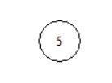
VISUALIZING INSERT OPERATION
Inserting the first node in the tree
Initially the tree is empty , so the first element inserted becomes the root element.

Slide 11
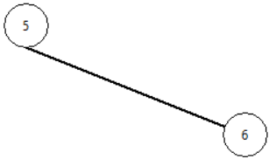
INSERTION OPERATION CONTINUED
INSERTING THE REMAINING NODES
The element inserted is larger than the root, so it is inserted as the right child of the root.

Slide 12
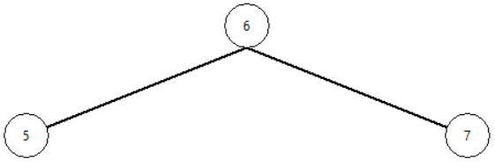
INSERTION OPERATION CONTINUED
The element inserted is larger than the largest element in the tree, so we insert it as the right child but the tree is not balanced , so we do left rotate operation which makes the Indexed AVL tree balanced.

Slide 13
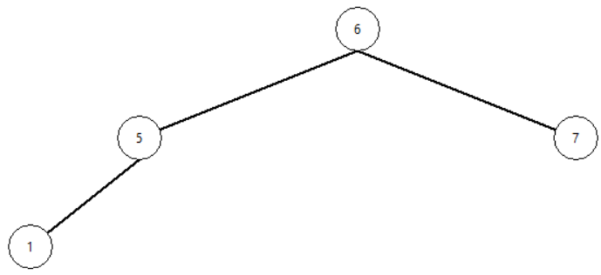
INSERTION OPERATION CONTINUED
The element inserted is lesser than the root , so the element will be a part of the left sub tree. The function insertNode is recursively called which finds the element's optimum location and inserts it.

Slide 14
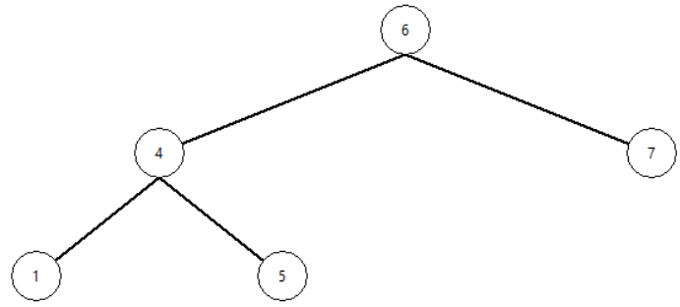
INSERTION OPERATION CONTINUED
The element inserted now ,in its optimal location causes the tree to be imbalanced as, difference between the heights of left and right sub tree is greater than 1. So the rotation is done twice to make the new element as a parent and make the tree to be balanced.

Slide 15
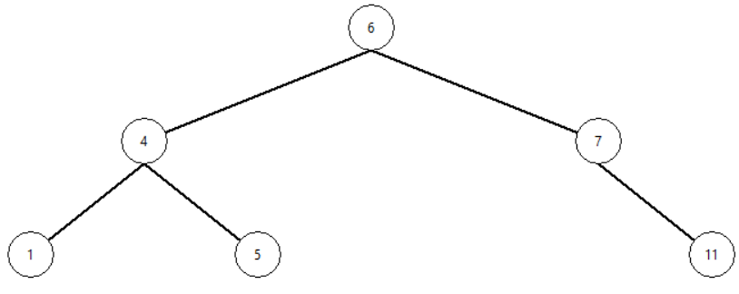
INSERTION OPERATION CONTINUED
The element to be inserted is greater than the root element, so the element will be part of the right sub tree. We check the tree if it's balanced after the element is inserted. In this case the tree is balanced.

Slide 16
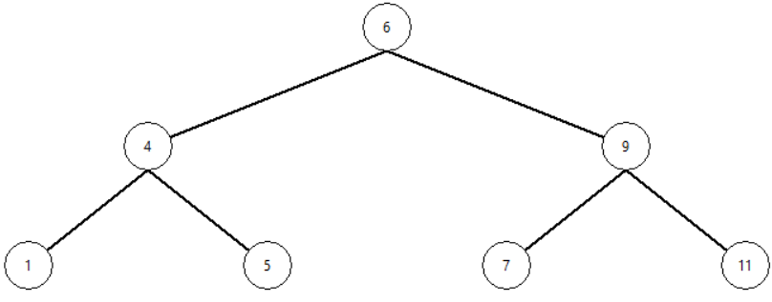
INSERTION OPERATION CONTINUED
The element now inserted in it's optimal position causes the tree to become imbalanced, so we do 2 rotations rotate left followed by rotate right operations to make the tree balanced.

Slide 17
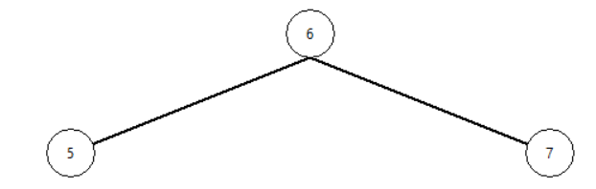
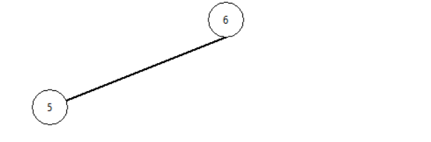
VISUALIZING DELETE OPERATION
Initially the tree consists of 3 elements , after delete operation, we check if the tree is balanced. In this case tree is already balanced.
This is updated tree after deletion. The element in the right sub tree is deleted.

Slide 18
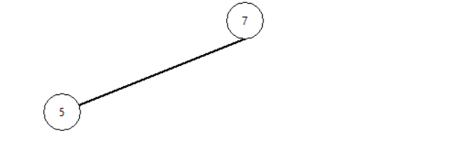
DELETING THE ROOT NODE
If the root is deleted, we check if the tree is balanced , in case it’s not balanced , we try to balance by either rotating the elements right or left.
This is updated tree after deletion. The root is deleted, and the rotation operation is done to make the tree balanced.

Slide 19
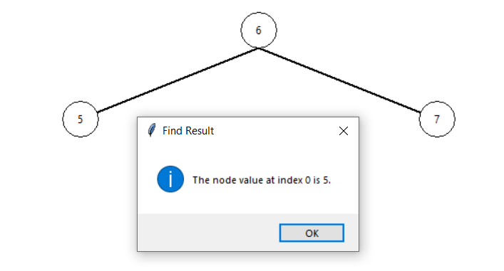
FIND ELEMENT BY INDEX
When you specify the index, a search operation is performed and if a value is found it returns the value found at that index.

Slide 20
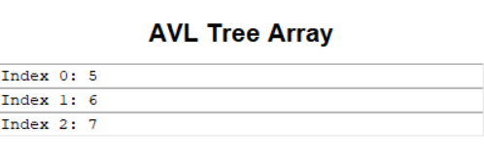
DISPLAY THE ARRAY WHOSE VALUES CORRESPOND TO THE CONTENTS IN THE TREE
Here the index positions correspond to the indexes of the element in the AVL Tree.

Slide 21
PRACTICAL APPLICATIONS OF INDEXED AVL TREE

Slide 22
SEARCH ENGINE
One of the most important application of indexed AVL tree is the Search Engine.
A search engine is an online tool or software program designed to help users find information on the internet
Search engines have certain components and processes associated with them like web-crawling, indexing, ranking algorithms, query processing, retrieval and display, and many more.
Some common search engines are Google Search, Microsoft Bing, Yahoo Search and DuckDuckGo

Slide 23
HOW INDEXED AVL TREE FUNCTIONS IN A SEARCH ENGINE
The search engine crawls web pages and extracts relevant information from them. This information is processed, and it stores this information in the tree. The node in the tree represents a web page and the data associated with the node includes page content , URL etc..
As the elements are added to the tree it balances itself and maintains indexing based on keywords which allows efficient search operations in the future.
When a user enters a search query, the search engine uses the indexed AVL tree to quickly retrieve web pages that match the query. The search query is processed, and the terms are matched against the index in the AVL tree.
Apart from retrieval, the tree also can rank the webpages according to the frequency of occurrence 0f keywords.

Slide 24
HOW INDEXED AVL TREE MANAGES THE UPDATES IN THE SEARCH ENGINE
Search engines need to handle updates and maintenance of the index to reflect changes on the web. When a web page is added, modified, or removed, the indexed AVL tree is updated accordingly. The AVL tree's self-balancing property ensures that the tree remains balanced during updates, maintaining efficient search performance.
Thus, we can conclude that the Indexed AVL tree provides an efficient way for storing and retrieving information in a search engine indexing system. It enables fast search operations, efficient ranking of search results and handles updates effectively.By using an indexed AVL tree, search engines can deliver accurate and timely search results to users, enhancing the overall search experience.

Slide 25
SOME OTHER APPLICATIONS IN THE DOMAIN OF COMPUTER SCIENCE
Database Indexing is another application where indexed AVL trees are used to create indexes in columns in a database system for fast retrieval of records.
Indexed AVL trees can also be used as symbol tables in programming language compilers or interpreters.. Symbol tables store identifiers (variables, functions, classes, etc.) along with their associated information for efficient lookup and resolution during compilation
It can also handle range queries. For example, in a time-series database an indexed AVL tree can be used to store timestamped data points, and the queries can be used to retrieve data within a given time range.

Slide 26
SOME OTHER APPLICATIONS IN THE DOMAIN OF COMPUTER SCIENCE
Indexed AVL trees can also be used in the field of computer networks to store the routing tables for efficient lookup of the address of the destination. The tree can be indexed based on network prefixes or addresses, allowing routers to quickly determine the next hop for forwarding packets.
They are also used in caching systems, to store frequently accessed or allocated data.
By combining an AVL tree and an array, you can create a hybrid data structure that provides fast insertion and removal operations while maintaining the elements in a sorted order. The AVL tree component facilitates efficient priority-based operations, while the array component allows for constant-time access to the highest-priority element, thus it helps in implementing an enhanced version of a priority queue.

Slide 27
PERFORMANCE Analysis

Slide 28
TIME COMPLEXITY OF VARIOUS OPERATIONS
Insertion: The indexed AVL tree has a time complexity of O(log n), where n is the number of nodes in the tree. This is because, the tree ensures that it is always in its balanced state. It involves 2 distinct operations namely searching and rotation both of which take the worst-case time O(log n). This time complexity is for best, worst, average-cases.
Deletion: Like insertion, the deletion operation too takes algorithmic time that is O(log n) where n is the number of nodes in the tree.
Searching: The time complexity of searching for an element in the hybrid data structure is also O(log n). This is because the AVL tree provides efficient search operations with a balanced tree structure, resulting in a height of O(log n).
Index-Based Access: Retrieving the value by index takes constant time that is O(1), the element can be easily accessed in the array if we know its index.

Slide 29
SPACE COMPLEXITY OF VARIOUS OPERATIONS
Memory Utilization: The hybrid data structure's space complexity is O(n), where n is the number of members in the AVL tree. Memory is needed for each node in the AVL tree to store the data, left and right pointers, height, and size. The memory use grows linearly as the tree's element count rises.
Overhead: Because of the indexing mechanism, the hybrid data structure has higher overhead than a straightforward AVL tree implementation. The indexing necessitates keeping track of each node's size information, which increases memory use. When compared to the overall memory utilization, this expense is, however, comparatively insignificant.

Slide 30
LIMITATIONS OF INDEXED AVL TREE

Slide 31
GENERAL LIMITATIONS
Handling: Managing a hybrid data structure is quite complex and can be a bit challenging. Also, the risk of getting errors be it compile time or runtime are also elevated.
Trade-offs in Balancing: Balancing the benefits of AVL trees (e.g., efficient search) with the benefits of arrays (e.g., memory efficiency) can be challenging. Striking the right balance between these components and optimizing their interaction might require careful design and tuning.
Maintaining the Overhead: Due to the necessity to preserve the balance of the AVL tree while controlling the array component, changes to the structure, such as adding or removing components, can be more complicated. This added complexity may influence performance and perhaps introduce issues.

Slide 32
CONCLUSION
The project focused on implementing and evaluating the Indexed AVL Tree, a hybrid data structure combining the benefits of AVL trees with efficient index-based access. Performance analysis revealed that the hybrid structure performed similarly to or slightly better than the AVL tree without indexing, while providing efficient index-based operations. It handled datasets of varying sizes and ordering scenarios effectively. The findings validated the practical applications and advantages of the hybrid structure, offering insights for future research. The project successfully achieved its objectives, providing valuable insights into hybrid data structures' performance and efficiency, guiding their design for specific application needs.

Slide 33
THANK YOU

